Slide 1


CIRA Labs
Secure Home Gateway
Project Vision - 2019
SECURE HOME GATEWAY PROJECT
May 2019
Notes:
Consider starting with a story of your vision – how did this come to be?

Slide 2




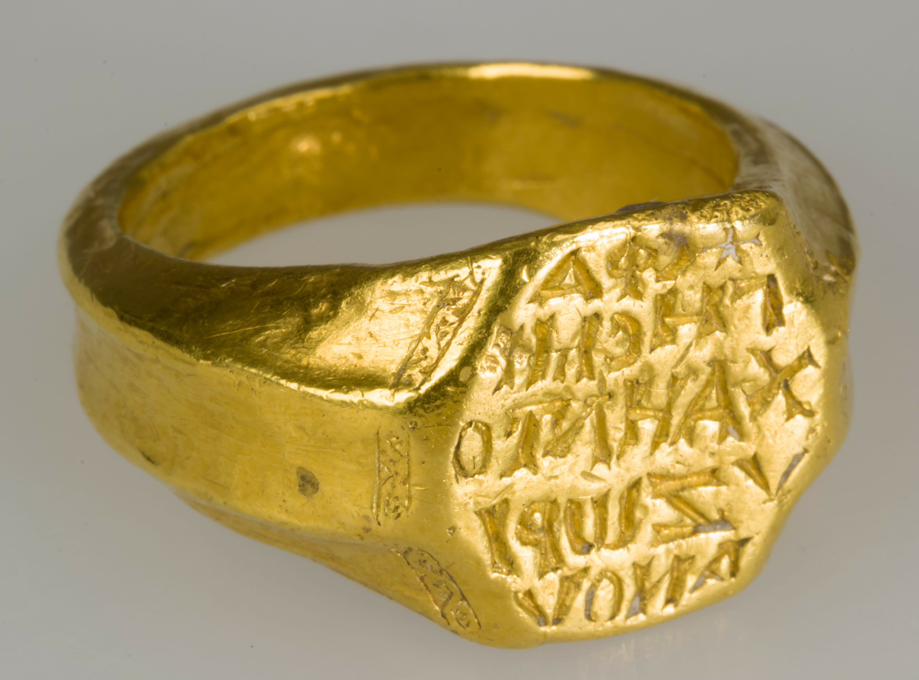




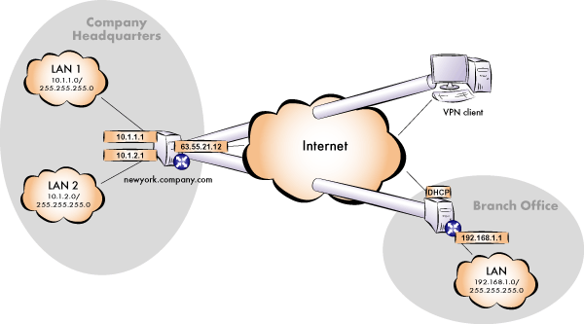
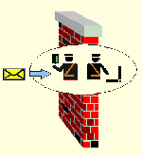
Who am I?
1996-
Michael Richardson.
Internet technologist, doing IP since 1988. “Garage Entrepreneur”
Xelerance Corp 2003-2007,2014-
(1998-2001)
FreeS/WAN (2001-2004)
BRSKI
2009-2017
(2007-2009)
ROLL – RFC6550
2012-
RFC4322
RFC4025
RFC5386
RFC8415
RFC7416
RFC8366
BRSKI
constrained-BRSKI
IETF standard security:IPsec/VPN
#4 at Milkyway Networks (1994-1996)

Slide 3




Project Evolution – From Idea in late 2016
In the home
Gateway
Need security access controls
Has to be easy to use
MIRAI Dyn Attack
October 2016
x
x
?
Need a new framework to prevent lightbulbs from killing the internet!

Slide 4

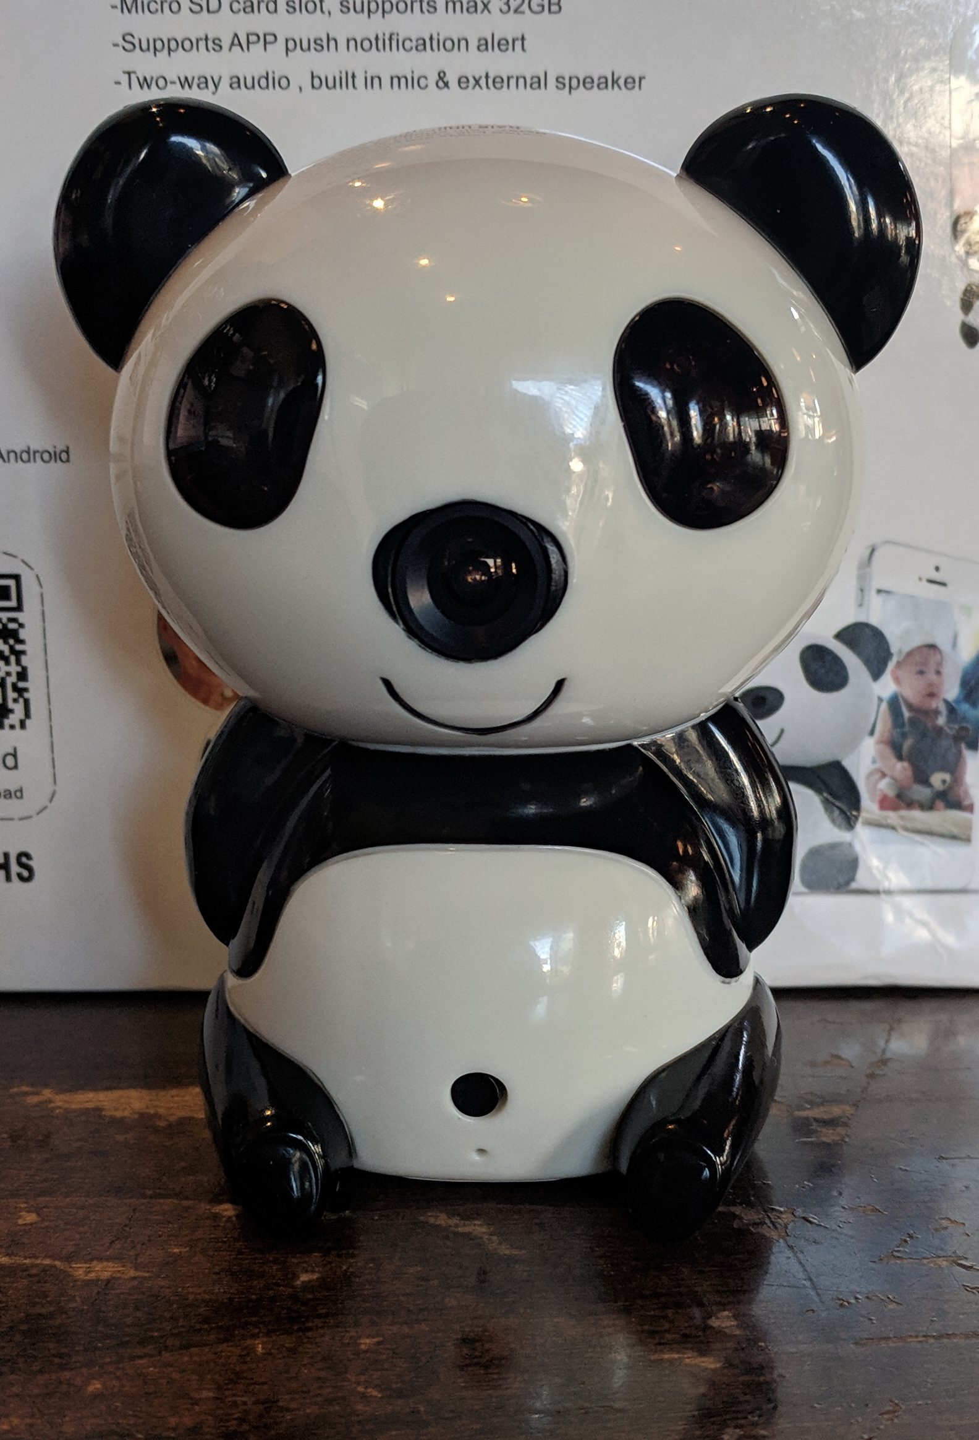


How networks are weaponized
Wide-open
UPnP
ATTACK
Critical
Infrastructure:
Power, gas, 911
Notes:
-> best practices and new standards (note to Jacques – please explain Per Device Access Policy (PDAP) for those who may not understand what it means)
Rule #1: Identify IoT devices on your home network
Rule #2: Place a policy around the IoT device that restricts it to a specific function (default is no access)
Rule #3: Monitor for behavioural changes in the device and quarantine at the first sign of change.

Slide 5








Best practices – Apply enterprise security framework to home networks
Home Security
PDAP
Appliances
PDAP
IoT Cloud
Services
Sensors
PDAP
Management
Application
PDAP: Per Device Access Policy
Scale Enterprise solutions to fit the home network
Notes:
-> best practices and new standards (note to Jacques – please explain Per Device Access Policy (PDAP) for those who may not understand what it means)
Rule #1: Identify IoT devices on your home network
Rule #2: Place a policy around the IoT device that restricts it to a specific function (default is no access)
Rule #3: Monitor for behavioural changes in the device and quarantine at the first sign of change.

Slide 6




IoT vendors are creating dependency on cloud architecture
IoT Cloud
Services
IPv6 with CIRA delegated names for the home makes this possible
Personal information is of great value to vendors
On the road
At home
Direct is better

Slide 7




New standards – MUD - Manufacturer Usage Description – RFC8520
I’m an ACME water sensor
- MUD File at: https://acme.corp/mud/ws1.0.json
MUD FILE:
- I have WIFI & apply the water sensor access policy
- I need to upgrade my firmware at https://acme.corp
- Configure me at https://myip/setup
- Alerts available at https://myip/alerts
It would be nice if the IoT device could advertise it’s current firmware version and/or current MUD file URL via WIFI or network connection (DPP, DHCP, LLDP…) on order to setup correct security profile

Slide 8


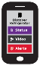






SHG
ACME.CORP
MUD
Repository
(1)
CIRA SHG
MUD Repository
MUD Supervisor
(3)
User accepts
provisioning
instructions
(2)
Send to
CIRA
(2)
Get vendor
MUD file
SHG
App
MUD Controller
(IP Tables)
(4)
IoT device added to network with specific network access controls
Network Access control:
Allow access to ACME.CORP
Allow to send alerts internally
Allow to be configured by app
Deny all other internet access
(1)
(4)
(1)
Scan MUD
QR code &
send to MUD
Controller
(DHCP in future)
MUD QR Code
ACME.CORP
IoT Water Sensor
Notes:
High Level MUD & IoT Device Provisioning Workflow

Slide 9
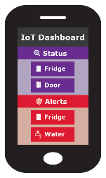
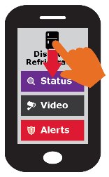
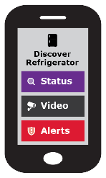







Simple user interface is key to this project
Swipe UP, DOWN, LEFT and RIGHT
Notes:
Gateway provisioning, device discovery, device provisioning must be as simple as possible, intuitive for non experienced users, available as framework for default open source app.

